Slide 1
spam detection
Mini-project on Machine learning
By
Akhil Reddy (15H61A05P9)
NagaSharma (15H61A05K4)
Sri Charan Desetty (15H61A05P0)

Slide 2
ABSTRACT
In the recent years, we have witnessed a dramatic increment in the volume of spam email.
Other related forms of spam are increasingly revealing as a problem of importance, specially the spam on Instant Messaging services (the so called SPIM), and Short Message Service (SMS) or mobile spam.
Our results demonstrate that Naive Bayes (NB) and Random Forest (RF) filtering techniques can be effectively transferred from SMS to SMS spam.

Slide 3

introduction
SMS spams are one of the concerns and many people do not like to receive them since they are annoying. Many SMS spam detection methods already exist and different classifiers were used, such classifiers depended on Support Vector machine, Naive Bays and many other machine learning algorithms.

Slide 4

SPAM DETECTION OBJECTIVES
To filter out the spam messages.
To protect from Cyber theft.
Content based SMS filtering

Slide 5
What is Machine Learning?
Machine learning is a subfield of computer science that evolved from the study of pattern recognition and computational learning theory in artificial intelligence.
types of machine learning
Supervised learning
Unsupervised learning
Reinforcement learning

Slide 6
procedure
The Basic algorithm for solving a task like this is:
Collect data and classify it
Divide dataset to train-set and test-set
Collect classifiers and vectorizers
Fit each classifier with train-set and calculate accuracy with test-set
Find classifier with the biggest accuracy

Slide 7
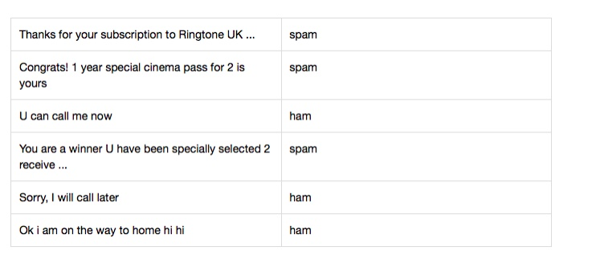
data-set selection
For this project, we chose the dataset SMS Spam Collection Dataset on kaggle.com This file contains a set of 5,574 SMS tagged messages in English. Each message is tagged as ‘ham’ (legitimate) or ‘spam’.

Slide 8
libraries included
numpy - general-purpose array-processing package. It provides a high-performance multidimensional array object, and tools for working with these arrays.
pandas - makes importing and analyzing data much easier. It builds on packages like numpy and matplotlib to give a place to do most of the data analysis and visualization work.
regular expressions - special sequence of characters that helps you match or find other strings or sets of strings, using a specialised syntax held in a pattern
SciKit Learn - Simple and efficient tools for data mining and data analysis.

Slide 9
Machine learning algorithms
For classification, we used library SciKit-learn. It contains many methods for:
classification and regression
k-nearest neighbours algorithm
decision tree-based model
Naive Bayes algorithms
Considering the previous research work and related work we chose Naive Bayes classifiers, a family of classifiers that are based on the popular Bayes’ probability theorem.

Slide 10
methods implemented
Fit() - method for training classifier
Score() - methods that returns the mean accuracy on the given test data and labels.
Predict_score() - method that returns probability estimates for each predictions.

Slide 11
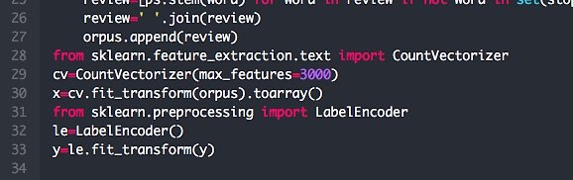
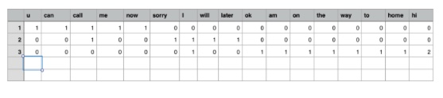
count vectorizer
It converts a collection of text documents to a matrix of token of unique words counts. It finds all unique words in text-set and makes one vector. After, it converts each text to an array of unique words counts. And as a result, we have one vector of unique words and many arrays with many count of zero.

Slide 12
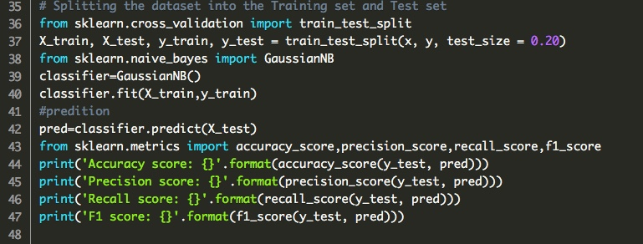
Naive bayes
Then, we divided the data-set(spam.csv) to two data-sets 1. Train-set 2. Test-set with the ratio 80:20.
We used train-set for training the classifier and test-set for calculation the accuracy using the Naive Bayes.

Slide 13
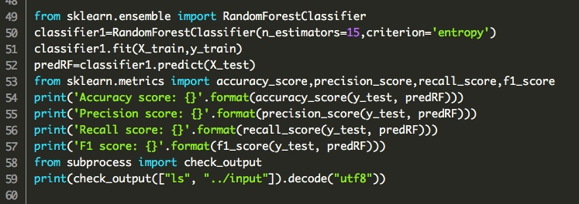
Random forest classifier
Then, we divided the data-set(spam.csv) to two data-sets 1. Train-set 2. Test-set with the ratio 80:20.
We used ensemble from SciKit Learn and applied Random Forest classifier on the test-set.

